Slide 1
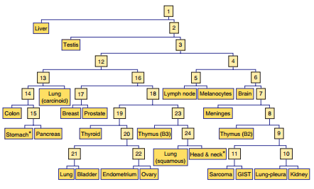
Characterizing cancer using gene expression or machine learning has precedence
Machine learning has been done for prediction of cancer prognosis.
Has looked at the specific genes of relevant tumor pathways and the deregulation based on sequence data.
Combined gene expression with clinical data.
Use Case-based reasoning to identify similar
patients within a tumor type, using gene expression
for relapse prediction.
Decision tree classifier to identify cancer
Machine learning applications in cancer prognosis and prediction. (Kourou et al. 2014)
Using epigenomics data to predict gene expression in lung cancer. (Li et al. 2015)
Using high-throughput transcriptomic data for prognosis: a critical overview and perspectives. (Domany 2014)
Case-based retrieval framework for gene expression data. (Anaissi et al. 2015)
Validation and Reproducibility of a Microarray-Based Gene Expression Test for Tumor Identification in Formalin-Fixed, Paraffin-Embedded Specimens (Pillai et al. 2011)
MicroRNAs accurately identify cancer tissue origin. (Rosenfeld et al. 2008)
Notes:
sergey

